Slide 1

AGB1211 – DESIGN THINKING
Department of Artificial Intelligence and Data Science
Academic Year: 2024 – 2025 (Odd Semester)
Year : II
Semester : III
Section : B
Date : 06/12/24
PRESENTED BY Guided By
VENKATACHALAM N Mrs.JOANY FRANKLIN(AP/
VIGNESWARAN K K.Ramakrishnan College of Technology.
YOGAPPRIYAN S
VINO AUGUSTIN V
AGB1211 – DESIGN THINKING

Slide 2
Title of the Project
WASTE AND SUSTAINABILITY IN HOSTEL
AGB1211 – DESIGN THINKING

Slide 3
Problem Identification
The Growing Issue of Waste in Hostels :
    Excessive waste generation from food, packaging, and personal items.
    Lack of proper waste segregation and recycling systems.
    Environmental impact due to inefficient waste management practices.
Proposed solution:
    Sends notifications to encourage sustainable practices.
    Tracks and improves waste segregation efforts.
    Encourages collective action through friendly challenges.
AGB1211 – DESIGN THINKING

Slide 4
Objective
To implement and promote sustainable waste management practices within the hostel, aiming to minimize waste generation, maximize recycling and composting efforts, and reduce the overall environmental footprint.
This will be achieved by raising awareness among hostel residents, providing adequate facilities for waste segregation, and encouraging energy and water conservation, with the goal of creating a greener and more sustainable living environment.
AGB1211 – DESIGN THINKING

Slide 5
BrainStorming
KEYWORDS
Sustainable Practices
Sustainable sourcing
Green cleaning
Eco-friendly
amenities
Biodegradable
products
Green certifications
Waste Management
Recycling
Composting
Waste segregation
Waste reduction initiatives
Zero waste
Community And Environmental Engagement
Digital detox
Community gardens
Upcycling
Energy Efficiency and Renewable Energy
Energy efficiency
Renewable energy
Solar power
Carbon footprint
Water Conservation
Greywater systems
Low-flow fixtures
AGB1211 – DESIGN THINKING

Slide 6
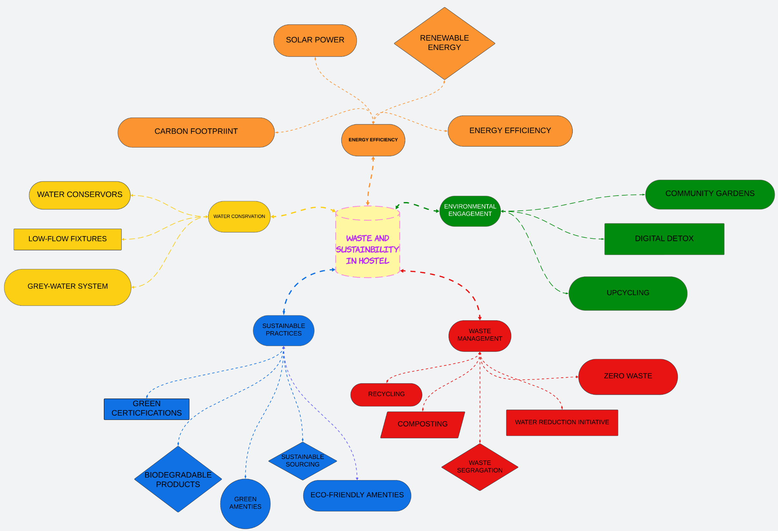
Mind Map
AGB1211 – DESIGN THINKING

Slide 7
Primary Research
Conducted surveys among hostel residents to understand waste habits.
KEY FINDINGS :
i) 60% residents are unaware of proper waste segregation.
ii) Common sources of waste include food, plastics, and paper.
iii) Interviews with hostel staff regarding waste disposal challenges.
AGB1211 – DESIGN THINKING

Slide 8
Secondary Research
Data on global hostel waste generation and its environmental impact.
Case studies of sustainable hostels implementing green practices.
Importance of reducing hostel carbon footprint for a sustainable future.
AGB1211 – DESIGN THINKING

Slide 9
Proposed Work
Daily Tasks : Log waste segregation activities, provide reminders, and track progress.
Service : Request waste pickup, view schedules, and give feedback.
Mail and Complain : Report issues, track resolution status, and suggest improvements.
General Features : User profiles, eco-tips via the info button, and responsive design.
AGB1211 – DESIGN THINKING

Slide 10
List of Modules
LOGIN MODULE
TASK MANAGEMENT MODULE
USER FEEDBACK & COMPLAINTS MODULE
USER COMMUNICATION & AWARENESS MODULE
AGB1211 – DESIGN THINKING

Slide 11
Module 1 Description
LOGIN MODULE
Purpose
• Provide secure access for users to the waste management system.
• Ensure personalized features based on user roles.
Implementation
• Use email and password-based authentication or single sign-on (SSO).
• Allow role-based access (resident, staff, management) for specific features.
• Include a "Forgot Password" feature for recovery.
Innovations
• Multi-factor authentication for enhanced security.
• Biometric login option for quick and secure access.
AGB1211 – DESIGN THINKING

Slide 12
Module 2 Description
TASK MANAGEMENT MODULE
Purpose
Assign and track daily waste management tasks for hostel staff and students.
Implementation
Create task lists with deadlines for segregation, recycling, and disposal.
Enable reminders and notifications for pending tasks.
Innovations
AI-based task optimization based on past task completion data.
Integration with calendars for task scheduling.
AGB1211 – DESIGN THINKING

Slide 13
Module 3 Description
USER FEEDBACK & COMPLAINTS MODULE
Purpose
Provide a platform for hostel residents to submit feedback or complaints about waste management services.
Implementation
Enable a "Mail and Complain" feature for users to voice concerns.
Allow attachments (e.g., photos of uncollected waste) for detailed reports.
Innovations
AI analysis of complaints to identify common issues and prioritize resolutions.
Automated acknowledgment and progress tracking for complaints.
AGB1211 – DESIGN THINKING

Slide 14
Module 4 Description (Cont..)
USER COMMUNICATION & AWARENESS MODULE
Purpose
Educate residents about sustainable practices and provide updates about hostel waste management.
Implementation
Use the app to display daily tips and progress reports on waste reduction.
Send notifications about upcoming recycling drives or initiatives.
Innovations
Interactive graphs showing individual contributions to waste reduction.
Gamification: rewards for sustainable practices.
AGB1211 – DESIGN THINKING

Slide 15
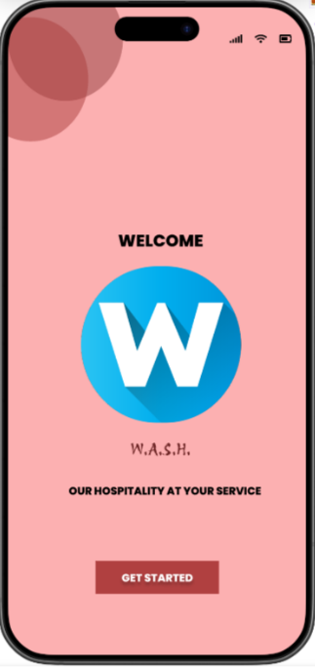
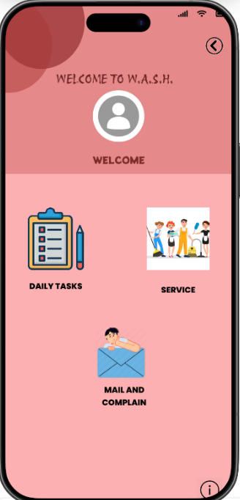
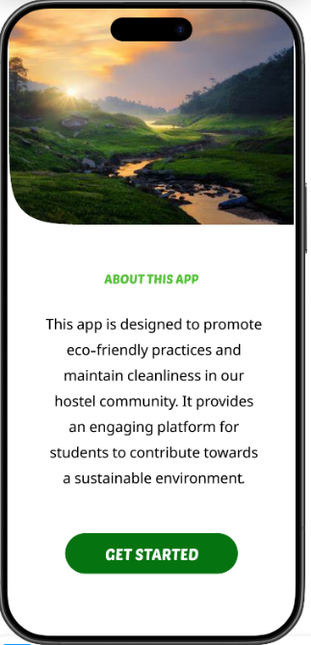
Results
AGB1211 – DESIGN THINKING

Slide 16
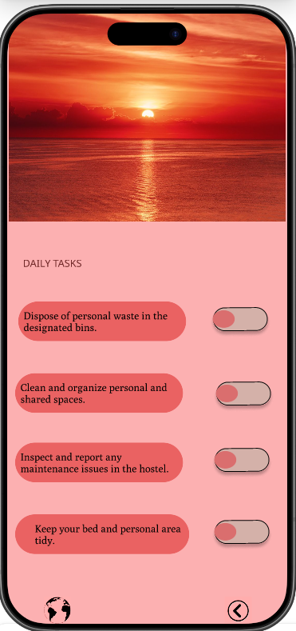
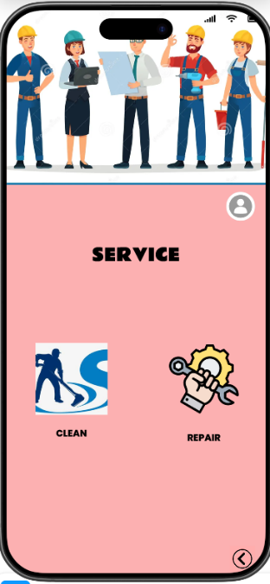
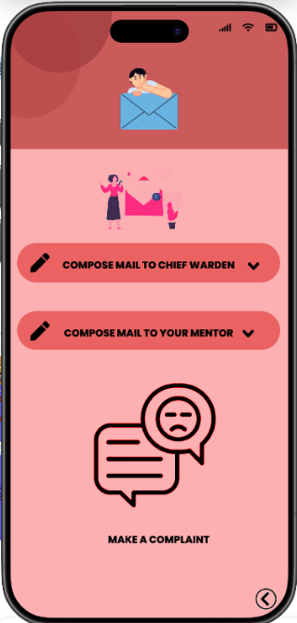
Results
AGB1211 – DESIGN THINKING

Slide 17
Conclusion
The Waste and Sustainability Management System promotes eco-friendly practices and efficient waste management in hostels through modern technologies like mobile apps, gamification, and real-time tracking. It addresses challenges in waste segregation and disposal with interactive guides, personalized notifications, and smart alerts, ensuring timely and effective waste management.For staff, centralized dashboards and collection trackers streamline operations and reduce the environmental footprint. Management benefits from data-driven insights and carbon footprint reports for informed decisions. Gamified features, such as eco-challenges and rewards, encourage resident engagement and foster a culture of sustainability.This system enhances operational efficiency, promotes environmental awareness, and builds a sense of community among residents, enabling hostels to reduce waste output and achieve sustainability goals.
AGB1211 – DESIGN THINKING

Slide 18
Thank You
ANY QUERIES???
AGB1211 – DESIGN THINKING

